Slide 2
Empower your staff to grow your business
Today’s webinar will cover:
Understand the value of succession planning
How to identify emerging leaders within your business
How to train up emerging leaders for future development
How to be assertive for better communication
Understand the importance of teaching good business acumen

Slide 3
Colin Wilson, Director KBA
Allyson Fletcher, HR Consultant /
Team Leader KBA

Slide 4
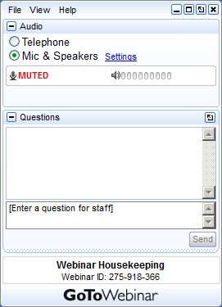
GoToWebinar Housekeeping

Slide 5
Mission
Purpose
Our Mission is to take businesses from Good to Great
Our Purpose is to take customers on a journey to help them improve their business through all aspects of employee engagement and performance

Slide 6
SPECIALISING IN:
Business Strategy & Growth
Tailored Business Plans
Strategic Planning
Engage an Advisory Board
Leadership Training
Management Training
Customer Centricity
Business Strategy Tailored Workshops
People & Culture
Employer & Staff Satisfaction Surveys
Personality Profiling / DiSC Profiling
Five Behaviors of a Cohesive Team
Emerging Leaders Program
Health & Wellbeing
HR Advice & Support
Recruitment & Induction
HR Consulting
HR Training & Support for Managers
HR Software & Training
Payroll & Rostering Services
HR Auditing
Performance Management
Workcover Claims
Sales Training
B2B - Sales Training
B2C - Sales Training
Telephone Sales Training
Retail Sales Training
Customer Service Training

Slide 7
TOPIC 1
Understand the value of succession planning

Slide 8
What is Succession Planning?
Key Points:
Succession planning is about identifying new talent who can replace current leaders when they decide to leave or retire.
Succession planning is also about developing these future leaders to prepare them, so they are ready to step up and take over for when that time is right.
Good companies that invest in succession planning, especially family businesses, who pass down the company reigns from one generation to another.

Slide 9
Where do most companies fail in Succession Planning
Key Points:
They leave it too late so this becomes a reactive situation rather than a proactive experience
The company hand selects the next person in line that may not be the best person for that role
The company does not recognise or know that there is future talent sitting right under their nose
The company does not train their next leader properly, and then they leave. This digs a deeper hole in the business with very little or no leadership in others
The company goes to market looking for their next leader which takes 6 to 12 months to train up and learn their systems

Slide 10
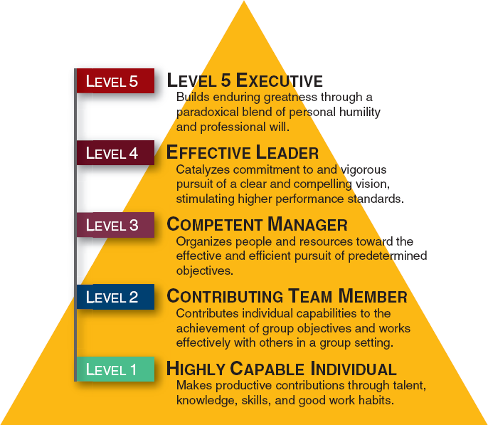
Good to Great
Jim Collins ‘Good to Great’ – Level 5 Leadership Model

Slide 11
TOPIC 2
How to identify emerging leaders within your business

Slide 12
How to identify your Emerging Leaders
Key Points:
Identify the staff who are highly capable individuals and are a contributing team member that has talent I.e. Leadership qualities
Ensure it is known in your company that your preferred option is to identify and promote within first, before you go to market for you next manager
Identify your future leaders through having good conversations I.e. Find out their ambitions
As part of a performance review process, set some goals and objectives around helping them become an Emerging Leader in your company
Officially make an announcement to all staff that this identified staff member/s are being groomed as a Future/ Emerging Leader within your company

Slide 13
How to empower your Emerging Leaders
Key Points:
You need to set some boundaries around what your emerging leader can do and not do
Make sure that you put a time line on what is expected of them, and how they will be trained
Set up a development plan for them for the next 12 to 24 months
Always ask them for their input on how to improve a situation within your company
Set tasks for them to take more ownership and responsibility
Recognition and praise

Slide 14
Don’t abuse the Emerging Leaders Role
Key Points:
Do not push them beyond their own capability or put them in a situation where they are vulnerable in front of their peers
Do not set expectations that they have to work harder I.e. longer hours
Do not give them responsibilities where they have to open and close the doors and not be paid for extra responsibilities e.g. Retail or Hospitality
Ensure that they understand that if they don’t lead by example, then this opportunity may be revoked from them

Slide 15
TOPIC 3 How to train up emerging leaders for future development
Notes:
Engage KBA to do a workshop

Slide 16
Leading Self – Training & Development
Key Points:
Assertive communication
Focus on the achievements
Commitment to the team and the company
Project a professional image
Develop strategic thinking
Managing responses to situations
Managing upwards
Meeting the expectations of the role which includes decision making
Have resilience

Slide 17
Leading Others – Training & Development
Key Points:
Building and maintaining relationships
Motivating your team
Performance Management
How to Coach and Mentor
Focus on teamwork
Focus on the right behaviours
Identify and mitigate risk
Consistent recognition
Understand how to deal with different personalities
Understand what leadership is

Slide 18
Lead & Manage a Team – Training & Development
Key Points:
Business Acumen - Understanding all parts of the business
- Key profit drivers
- Customer experience/ advocacy
Lead and managing change
Effective preparation and communication
Adopt sales and support initiatives
Problem solving and decision making
Managing or facilitating meetings and training sessions
Inducting others
Leading with Professionalism
Notes:
Great tool to be used to re-energise the team and uplift the moral and shaping direction and goals
acknowledged – by signing each document, or acknowledging via eSS on HRIS

Slide 19
TOPIC 4
How to be assertive for better communication

Slide 20
Setting Expectations of Assertiveness
Key Points:
As you develop your emerging leader, you must focus on being more assertive with one and another for mutual respect and understanding
When you empower an emerging leader to lead, one of the things they must learn as a leader is to be very clear with their communication by being more assertive
Your emerging leader must develop an assertive style that acknowledges other team members point of view and can communicate their disagreement rationally in an amicable manner

Slide 21
The Importance of Communication
Key Points:
Communication is everything in a company as it provides clear guidelines for everyone to follow such as:
Company Strategy, Budgets and KPIs
Company goals and objectives
The reasons why you do what you do
Team meetings and training sessions
Customer expectations
Company and individual performance outcomes
Celebration of wins with recognition & praise
Notes:
Case Study – About not able to read policies

Slide 22
The importance of Managing Upwards
Key Points:
For an Emerging Leader, ‘Managing upwards’ is all about taking ownership
They must take responsibility for managing upwards and be more effective with their communication
This is about ‘THEM’ being part of the leadership team and to behave like a leader
They must follow your company mission, vision and values
They must have a sense of purpose of what the business is trying to achieve
They must take responsibility to support the business and lead the team as if they were the Manager

Slide 23
TOPIC 5
Understand the importance of teaching good business acumen

Slide 24
Teaching your Emerging Leaders good Business Acumen
Key Points:
Many people in a company do not understand ‘Business Acumen’
It is about how a company makes money
It is about how the company performs on a daily, weekly, monthly, quarterly and yearly basis
It is about all the parts that move within the business as per your P&L
Teaching your Emerging Leaders about the Business Acumen of your business develops them into a better leader!

Slide 25
Teaching them the ropes of the business
Key Points
This is all about how your company operates incorporating:
People & Culture
Sales & Marketing
Products and Services
Customer Experience
Purchase of Stock and Write-Offs
Budgets and Targets
Company Expenses
Cashflow
Company Risk
Profit & Loss

Slide 26
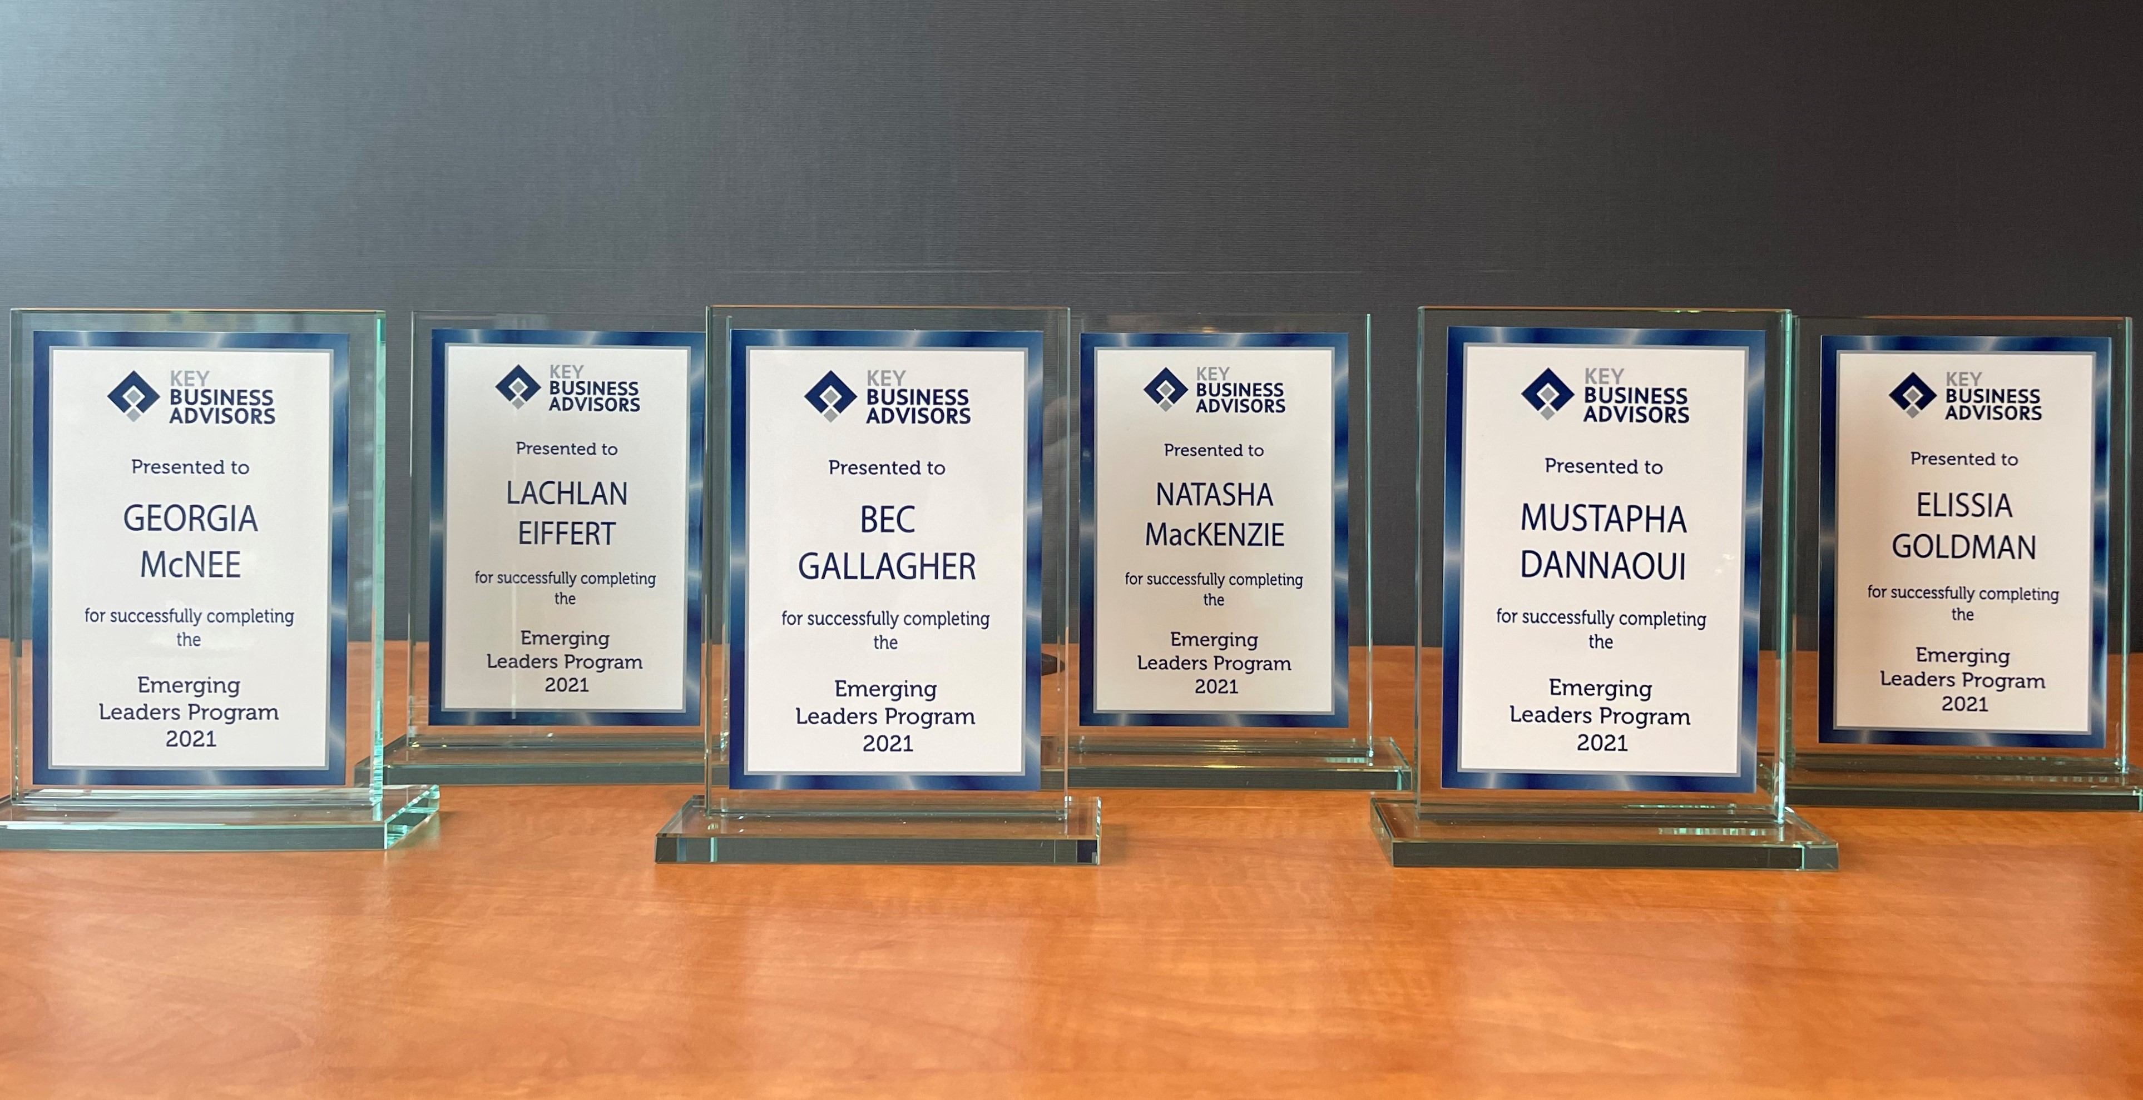
Download information about our ‘Emerging Leaders Program’
https://keyba.com.au/leadership-training/emerging-leaders-program/

Slide 27
Any Questions?
Call 1300 4 ADVICE
E: info@keyba.com.au
w: www.keyba.com.au

Slide 28
www.keyba.com.au or email: colin@keyba.com.au

Slide 29
Topics Include:
Upcoming webinar –
13th September 2021
The Value of Great Customer Service
Setting expectations around customer service
Understand the value of your customer
Understand the power of great teamwork
How to deal with angry customers
How to create a Raving Fan!
Presenters:
Colin Wilson, Director, Key Business Advisors
keyba.com.au/upcoming-events

Slide 30
KBA LIVE ONLINE TRAINING
Performance Management Online Workshop – Wednesday 8th September
Grow More Sales Online Workshop – Wednesday
6th October
People & Culture Online Workshop – Wednesday
3rd November
Business Strategy Online Workshop – Wednesday
1st December
https://keyba.com.au/upcoming-events/

Slide 31
Thank you for attending today’s webinar.
Call KBA on 1300 4 ADVICE for any advice or go to www.keyba.com.au
Stay Safe!

