Slide 2
Understanding the Value of a Good Sales Process
Today’s webinar will cover:
How to prospect and engage with potential customers
How to network yourself into opportunities
How to use marketing methods to leverage more sales
How to present the best solutions to your potential customers
How to handle objections and close the sale

Slide 3
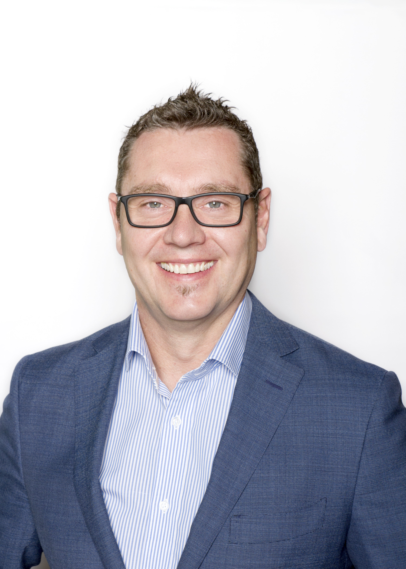
Colin Wilson, Director KBA

Slide 4
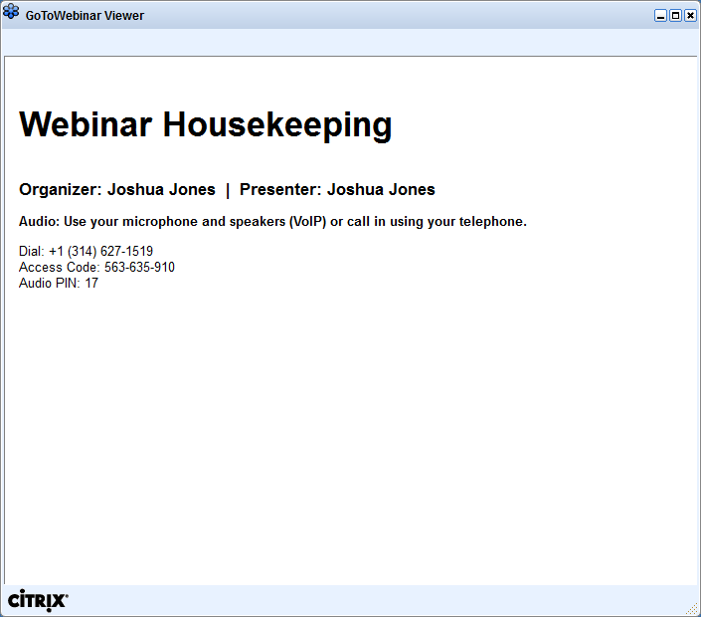
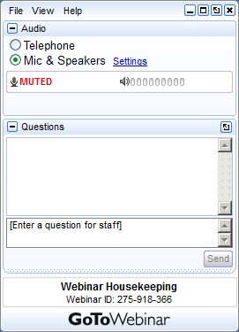
GoToWebinar Housekeeping

Slide 5
Mission
Purpose
Our Mission is to take businesses from Good to Great
Our Purpose is to take customers on a journey to help them improve their business through all aspects of employee engagement and performance

Slide 6
SPECIALISING IN:
Business Strategy & Growth
Tailored Business Plans
Strategic Planning
Engage an Advisory Board
Leadership Training
Management Training
Customer Centricity
Business Strategy Tailored Workshops
People & Culture
Employer & Staff Satisfaction Surveys
Personality Profiling / DiSC Profiling
Five Behaviors of a Cohesive Team
Emerging Leaders Program
Health & Wellbeing
HR Advice & Support
Recruitment & Induction
HR Consulting
HR Training & Support for Managers
HR Software & Training
Payroll & Rostering Services
HR Auditing
Performance Management
Workcover Claims
Sales Training
B2B - Sales Training
B2C - Sales Training
Telephone Sales Training
Retail Sales Training
Customer Service Training

Slide 7
TOPIC 1
How to Prospect and Engage with Potential Customers

Slide 8
What is your reason for the call?
Key Points:
Customer service call
Research call
Call for an appointment
Call to sell a product or service over the phone
Follow up on a campaign
Referral / inbound sales lead
Presentation / Demonstration
Follow-up call from past dealings
Follow-up the next step from a proposal
Call to ask for commitment and close the sale

Slide 9
What is your preparation plan?
Key Points:
Have you researched the company and person you are calling?
Is it a cold call, warm or hot lead?
Is the call linked to a campaign that you/ your company is running?
Have you identified 3 to 4 main points you need to make?
Do you have a list of questions you want to ask?
Do you have a call script?
Have you prepared your response for the most common objections?

Slide 10
What is the purpose of your call?
Key Points:
Write down your call script. After your introduction get straight to the point.
THE REASON FOR MY CALL IS.........
If not interested: Sell the reasons why you have called them again (Sell the Added Value and Benefits of your products or services)
Wait for the Buying Signals and either Close the Deal or Appointment
Or plan for next follow up call
Enter updated information into database
*See KBA Prospecting Call Objective Sheet

Slide 11
See KBA’s 9 Step to Successful Prospecting and
Selling Over the Phone
https://keyba.com.au/free-sales-checklists/

Slide 12
TOPIC 2
How to Network Yourself into Opportunities

Slide 13
The Power of Networking
Key Points:
Networking Events (BNI, Industry Associations, Local Government Events etc..
Social Responsibility – Give back!
Being referred into someone else’s network is KEY
Social Media is a powerful networking tool
LinkedIn
Facebook
Instagram
Twitter
Networking is about finding someone who likes you and what you do where they endorse you to others!
Every day you are networking!

Slide 14
The Secret to Networking Events
Key Points:
Don’t sell and spray them with what you do
Be professional and ask questions (Chit-Chat)
Be interested in who you are talking to
Find 5-6 people who have the same values, are aligned and are as passionate as you!
Arrange to catch up with them afterwards (test the water) via a call, Zoom or a coffee meeting afterwards
Connect with them on LinkedIn
Take interest in what they are posting and doing, again do your research (Look at their Company’s Google Reviews)

Slide 15
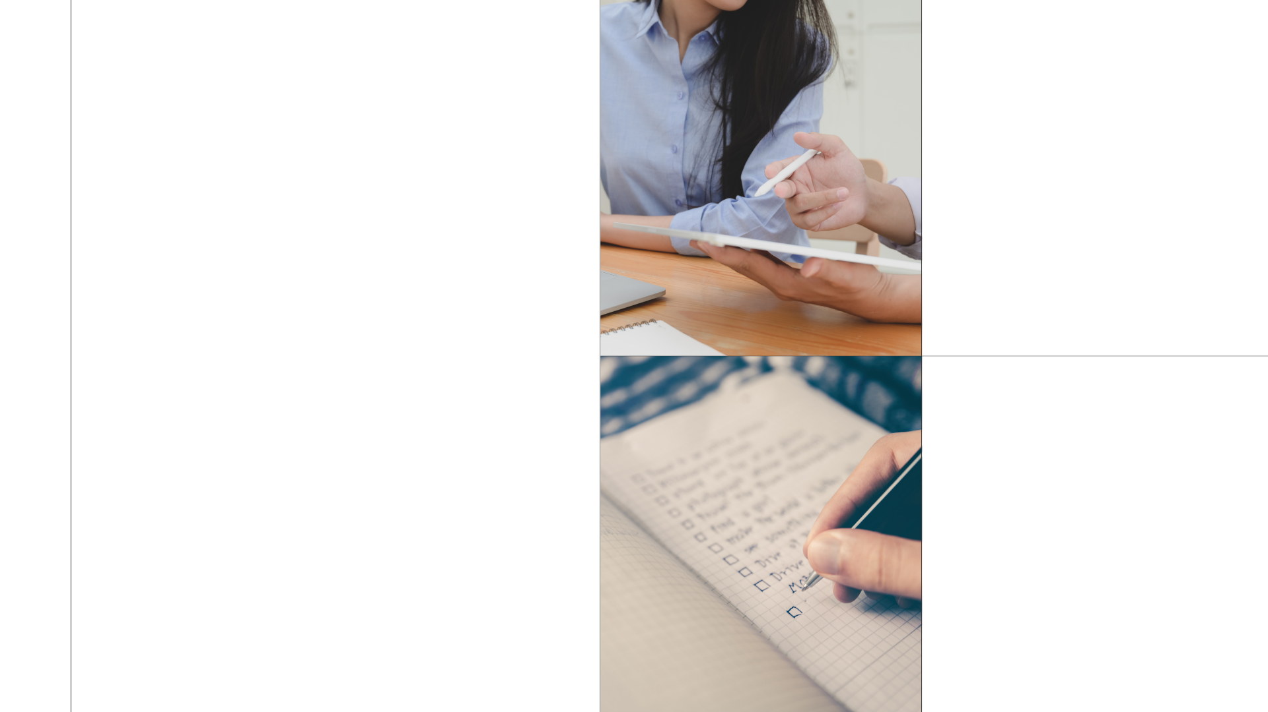
TOPIC 3 How to use Marketing Methods to Leverage More Sales
Notes:
Engage KBA to do a workshop

Slide 16
Creating Lead Generation – Building a Sales Engine
Key Points:
Referrals are No 1.
A great website with useful information
Product & Services Brochures
Downloadable information & tips
Send out good articles - Newsletters/ Blogs
Use the power of Social Media
Webinars/ Zoom Presentations
Company Events/ Launches (Breakfast, Lunch or Evening)
Other Advertising (Google/ Facebook Paid Ads, Flyers,
Networking Events

Slide 17
Build Sales Opportunities/ Pipeline
Key Points:
Follow up on lead opportunities
Make an appointment (Zoom or Face-to-Face)
Understand the difference between a Suspect, Prospect and Qualified Prospect
Listen to what your customers want
Follow a structured Sales Process
You need Tools of Trade to demonstrate/ present your recommended solution
Are they looking for pricing or a formal proposal from you?
What is your client strategy to win more business?

Slide 18
Is your Company set up with the following?
Key Points:
Brochure Material (Digital and Hard Copy)
Service menu of Products and Services
Any research or published information
Planned – Phone Call Sheets / Appointment CNA
Proposals/ Quote templates
Testimonials / Case Studies / Good Google Reviews
CRM Database of current and potential clients
Sales Kit Folders – iPad, Tablet or Laptop
Other advertisings material – I.e. Website
Good Social Media content
Notes:
Great tool to be used to re-energise the team and uplift the moral and shaping direction and goals
acknowledged – by signing each document, or acknowledging via eSS on HRIS

Slide 19
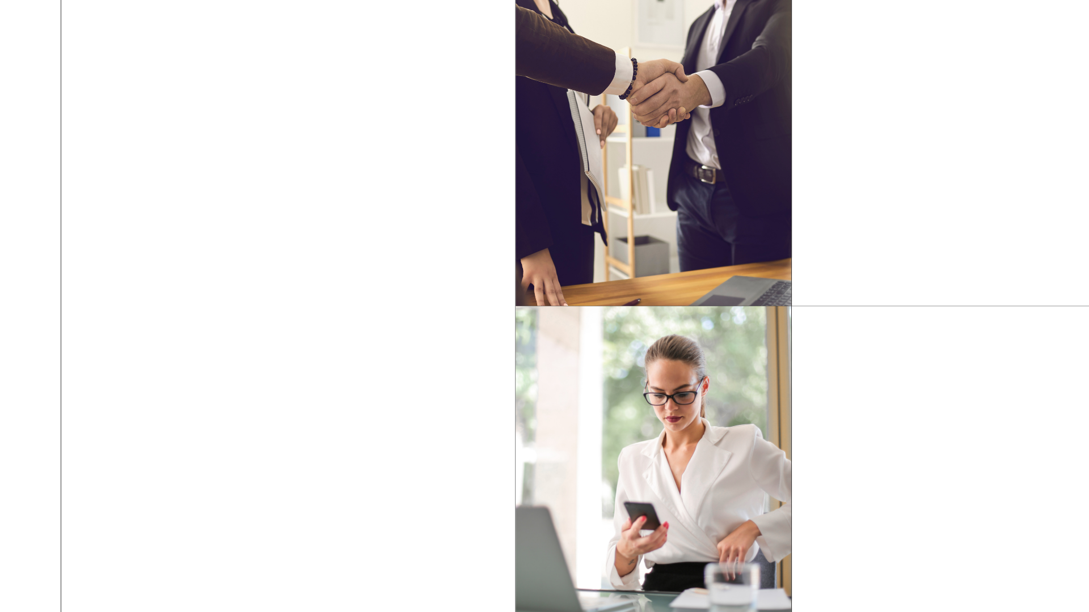
TOPIC 4
How to Present the Best Solutions to your Potential Customers

Slide 20
How prepared are you?
Key Points:
Do you have the Tools of Trade to demonstrate and present a solution to your current and potential customers?
How good is your product and industry knowledge?
Do you see yourself as a Professional Sale Consultant?
Do you have the confidence to interact, engage and ask key questions?
Do you have the confidence in presenting and demonstrating a solution?
Do you have the confidence to set the sale up to close the opportunity?

Slide 21
How to Engage with Customers – New Opportunities
Key Points:
No 1. You need to build rapport with your potential customer
The secret is to ask questions 80/20 rule
Open-Ended Questions
Fill up a bucket of information based on what the customer is looking for – Their needs NOT yours!
Based on the information gathered you are then in a position to present and demonstrate your recommended solution
And you say to your customer: Based on what you have told me, I have a good, or a couple of options I would like to present to you!
Notes:
Case Study – About not able to read policies

Slide 22
Presenting your recommended solution to your Potential Customer
Key Points:
No 1. Slow your speech down when presenting
Based on what you have told me, my recommendation is….
Use all forms of learning methods being Visual, Auditory and Kinaesthetic
Sell the Features, Benefits and Added Value of what you are recommending (Product and Service)
Listen for the buying signals
Watch the body language
Use Soft Trial Closes I.e. Is this what you're looking for?
Ask them is there anything you have not covered to bring out the objections

Slide 23
TOPIC 5
How to Handle Objections and Close the Sale

Slide 24
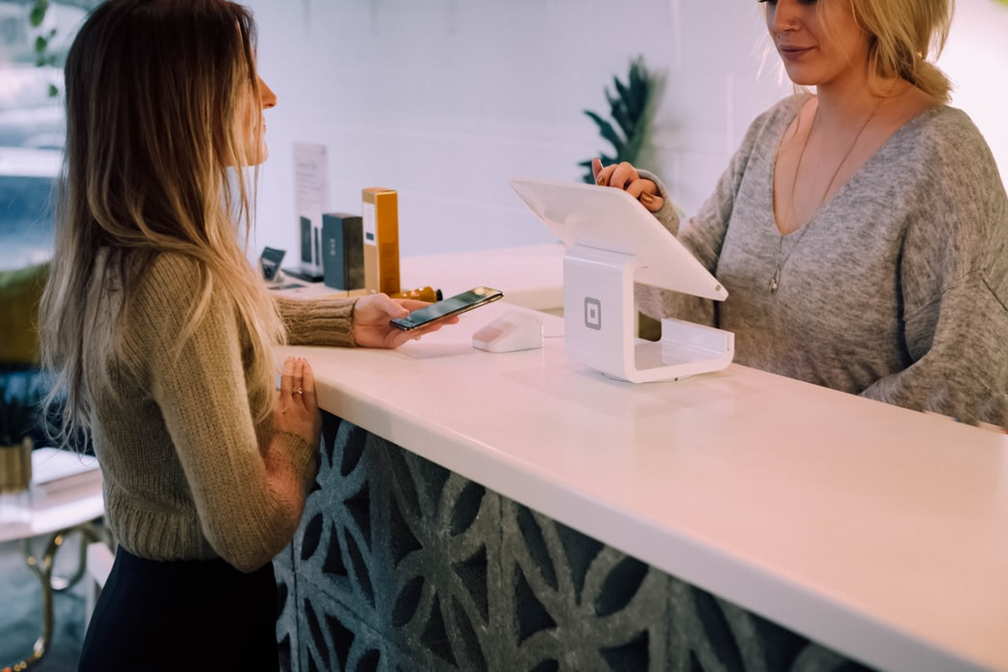
Objections are healthy!
Key Points:
Do not be afraid of objections because it is a sign of engagement (unless they ask stupid questions)
If you ask the right questions at the start of the sales process, then 80% of your objections can be minimised
If you don’t know the answer to an objection, do not panic, let them know that you will get back them
Think about a 3rd Party Close in having someone come into your sale where they can answer your potential customer’s questions that you don’t know the answer

Slide 25
Understanding Closing Techniques?
Key Points:
Soft Trial Close
Hard Close
Alternative Close
Assumptive Close
3rd Party Close
Comparison Close
Summary Close

Slide 26
The Perfect Appointment
Key Points
Introduction (Meet & Greet)
Ask questions & qualify your potential customer
Identify the opportunity
Present and demonstrate what you can do for this potential customer and make sure there is interest
Showcase your products and services, use your tools of trade, show them brochures, case studies, testimonials as proof of concept
Use the right closing techniques that suits that customer
Answer any objections and close the sale
Make every opportunity count and thank the customer for their business!

Slide 27
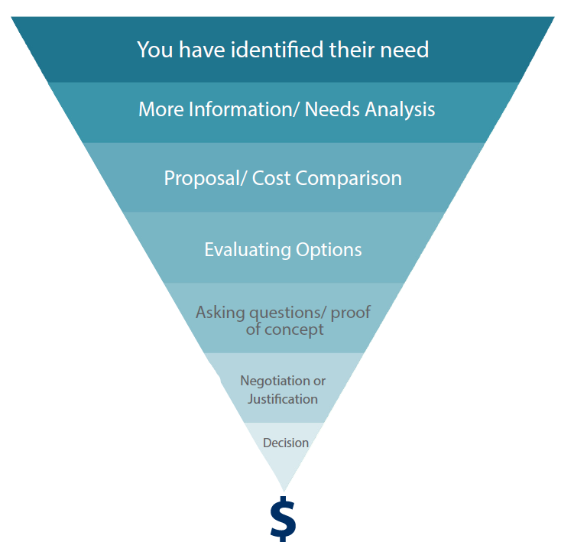
The Sales Funnel

Slide 28
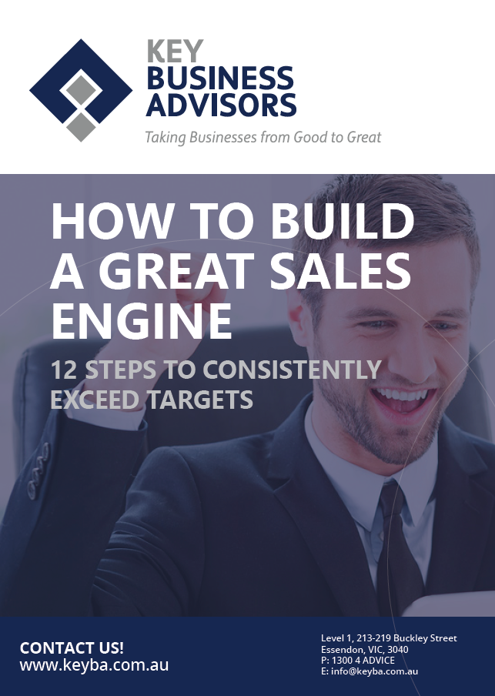
Download our Free ‘How to Build a Great Sales Engine’
https://keyba.com.au/free-sales-checklists/
Also see other KBA downloads such as:
7 Steps to Retail
11 Steps to Business to Consumer
12 Steps to Business to Business
10 Steps to Provide Excellent Customer Service

Slide 29
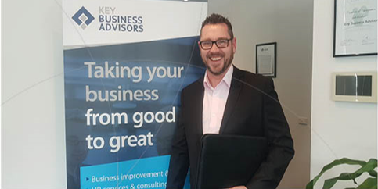
Sales Training Consultation Meeting with Colin Wilson
Normally $350 p/h
For Webinar Participants: The First 2 hours with Colin Wilson is reduced to $200 p/h
This offer ends 7 days after this webinar
Let KBA help you with our services
Business Strategy & Growth
People & Culture
HR Advice & Support
Sales Training

Slide 30
Join us on Tuesday, 17 August 2021 – KBA Workshop
KBA Sales Masterclass facilitated by Colin Wilson
Register https://keyba.com.au/workshop/b2b-sales-masterclass/?b2b-sales-master-class-full-day-workshop-melbourne

Slide 31
Any Questions?
Call 1300 4 ADVICE
E: info@keyba.com.au
w: www.keyba.com.au

Slide 32
www.keyba.com.au or email: colin@keyba.com.au

Slide 33
Topics Include:
Understand the value of succession planning
How to identify emerging leaders within your business
How to train up emerging leaders for future development
How to be assertive for better communication
Understand the importance of teaching good business acumen
Presenters:
Colin Wilson, Director, Key Business Advisors
Allyson Fletcher, HR Consultant / Team Leader, Key Business Advisors
Upcoming webinar –
16th August 2021
Empower your Staff to Grow your Business
keyba.com.au/upcoming-events

Slide 34
Thank you for attending today’s webinar.
Call KBA on 1300 4 ADVICE for any advice or go to www.keyba.com.au
Stay Safe!

